Slide 1
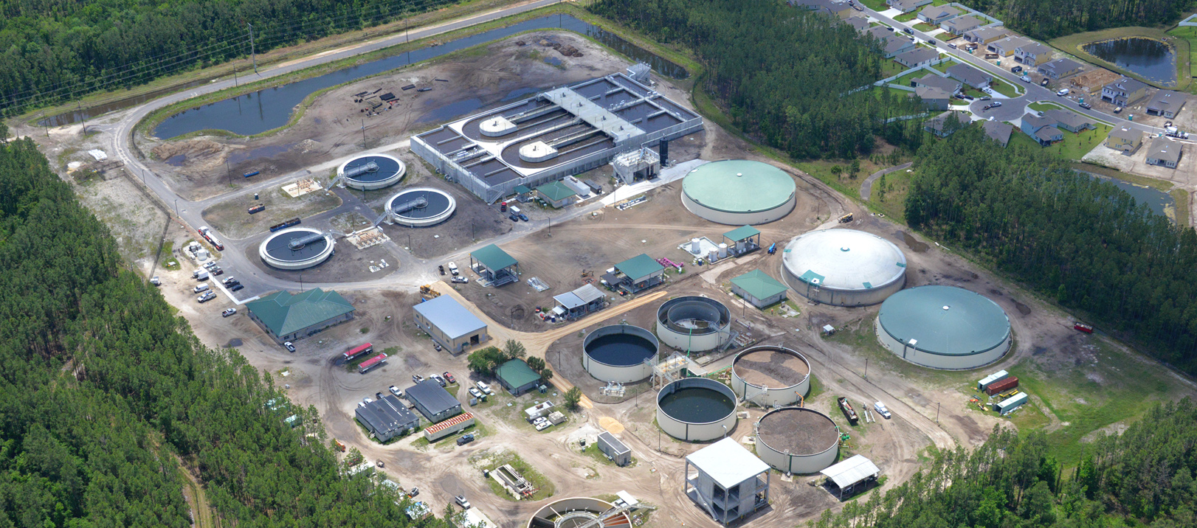

COJ Resiliency Subcommittee on Infrastructure Continuity of Operations
Hai Vu, Interim GM Water/Wastewater Systems
Brian Roche, Interim Chief Financial Officer
October 8, 2020

Slide 2
Agenda
Impact of the county's 65,000 septic tanks on the environment/water quality and JEA's plan to eliminate or upgrade
Plans to upgrade treated water quality discharge into the St. Johns and alternatives to re use rather than discharge
Expansion of treated stormwater for irrigation plan
Diversification of energy sources for energy production and plan to reduce fossil fuels as a percent of the total to reduce greenhouse gas emissions

Slide 3
Agenda
Impact of the county's 65,000 septic tanks on the environment/water quality and JEA's plan to eliminate or upgrade
Plans to upgrade treated water quality discharge into the St. Johns and alternatives to re use rather than discharge
Expansion of treated stormwater for irrigation plan
Diversification of energy sources for energy production and plan to reduce fossil fuels as a percent of the total to reduce greenhouse gas emissions

Slide 4
Impacts of Septic Tanks
Sources of Pollution
Central sewer systems
Septic tanks
Stormwater runoff
Fertilizer and pesticides
Discharges from farmlands
Sediments from construction sites
Industry
https://www.sjrwmd.com/education/water-pollution/
1998 FDEP Data
“The three most common water quality concerns are fecal coliform, nutrients, and oxygen-demanding substances…[Septic tanks] were deemed…to be one of the most probable sources of fecal coliform
Potential contaminants that degrade the quality of surface and groundwater resources as a result of septic system failure include disease causing bacteria, infectious viruses, household chemicals, and nutrients (nitrates and phosphates).
(http://duval.floridahealth.gov/)
Notes:
Florida’s [septic tanks] are problematic for three reasons: the state’s high groundwater level, relatively low levels of organic matter (i.e. bacteria) in the soil and the soil is so porous and sandy

Slide 5
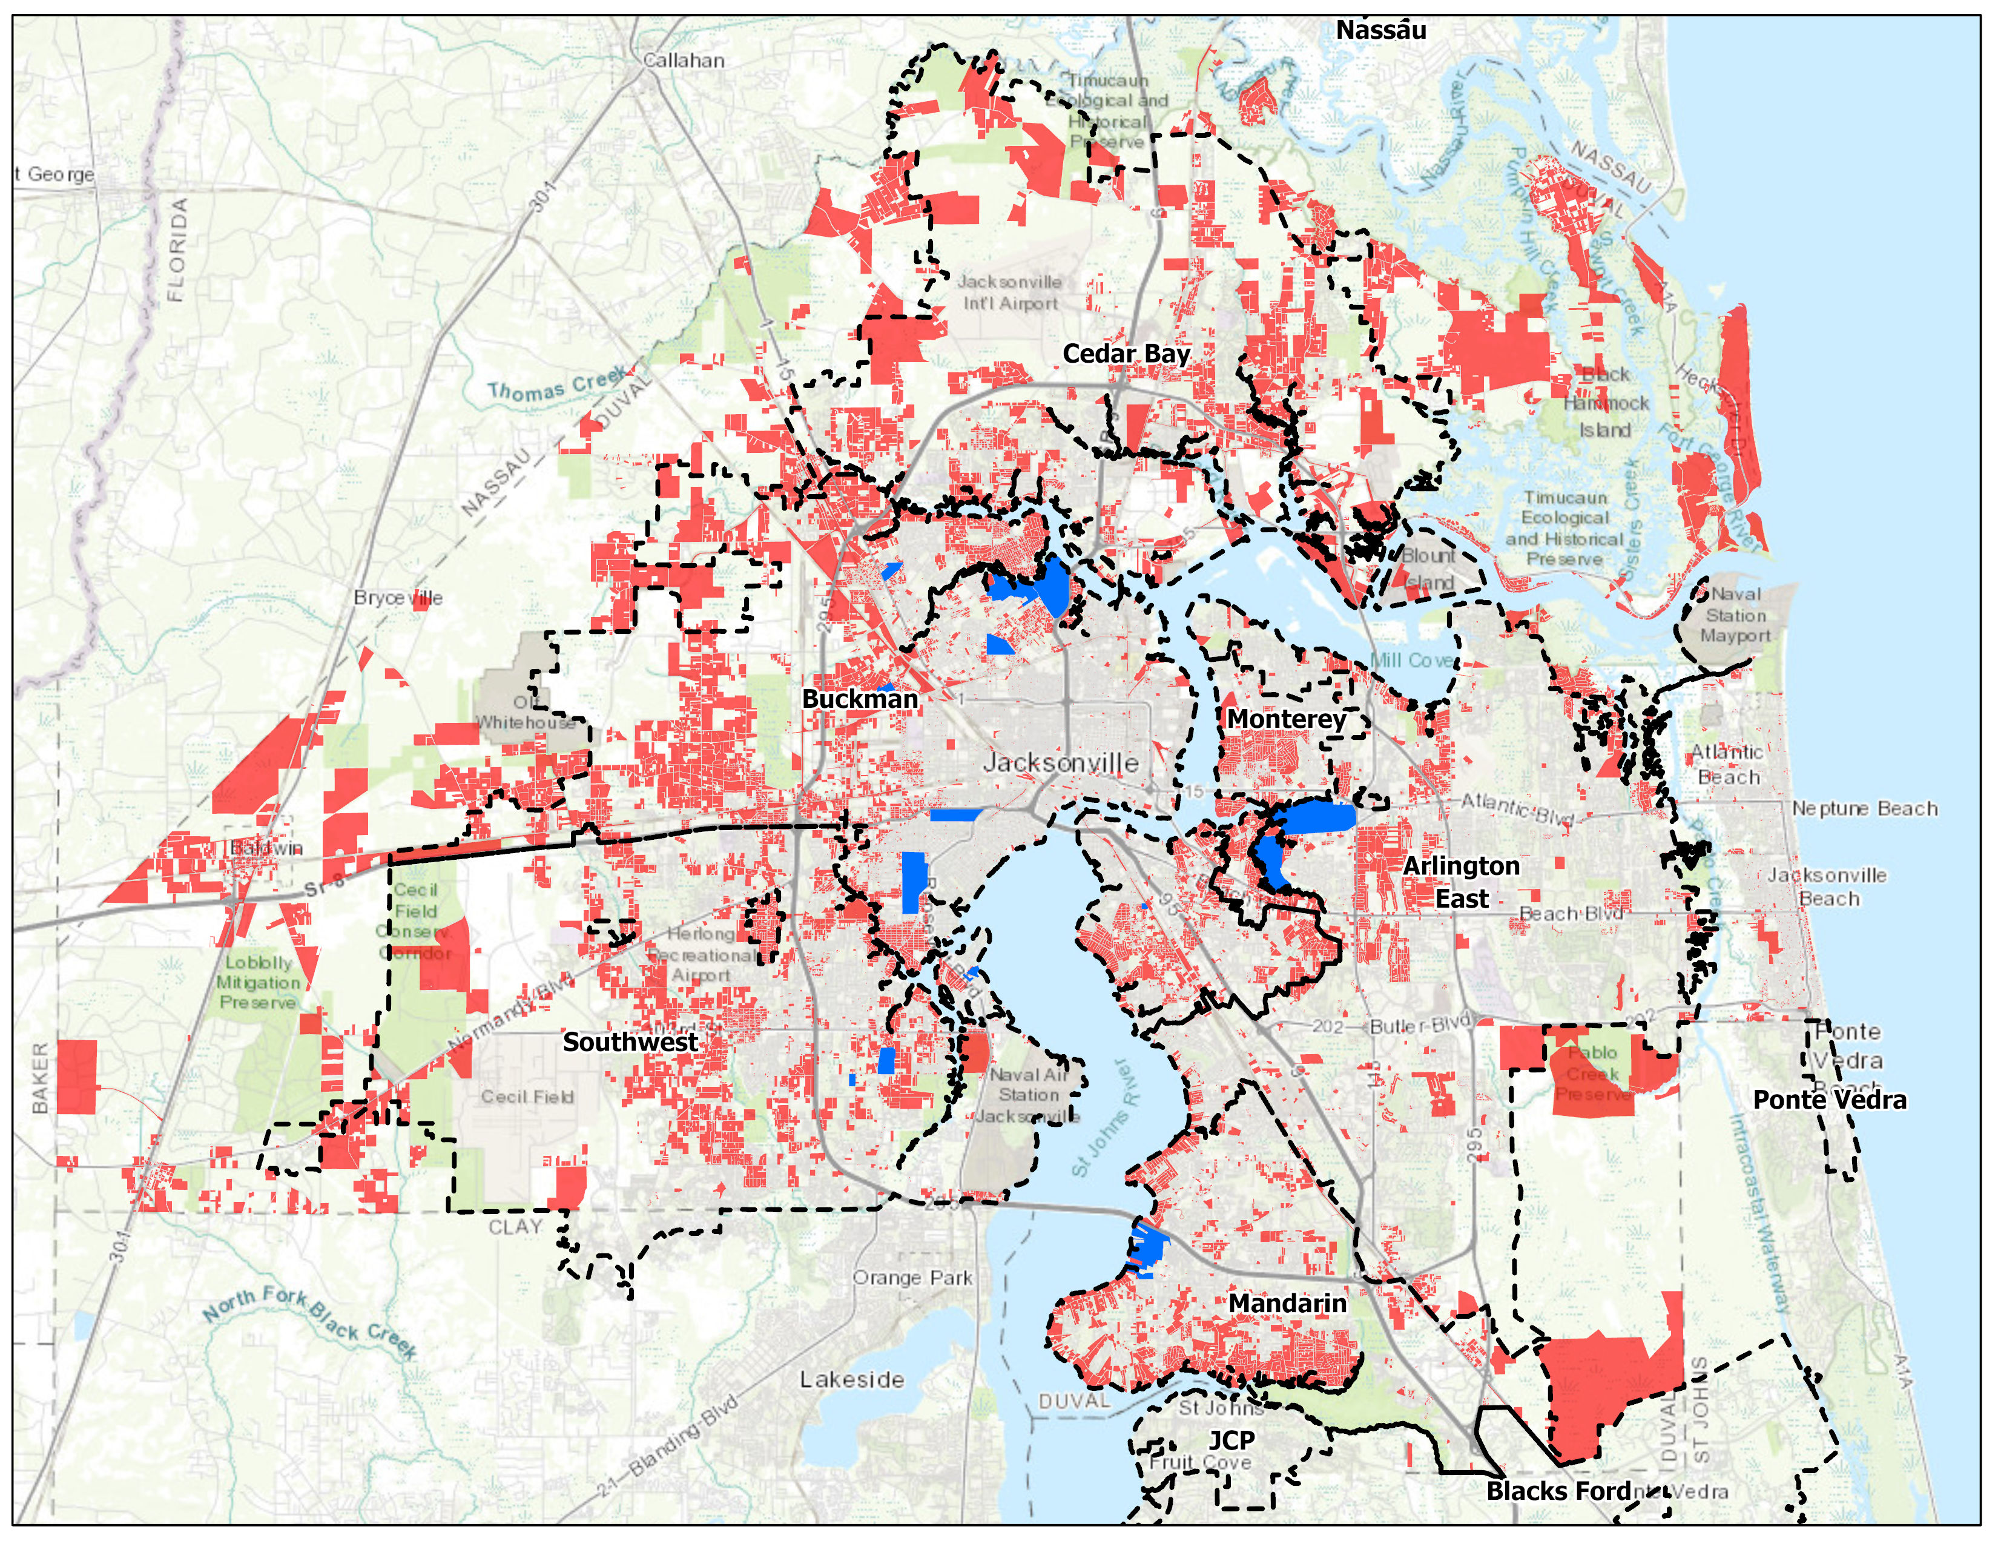
COJ and JEA have an active septic tank phaseout (STPO) program
Septic Tanks
STPO Areas Converted or
In-Process
65,000 septic systems and 35,000 private water wells remain
In 2003 Water & Sewer Infrastructure Task Force identified Septic Tank Failure Areas
Notes:
Providing central water and wastewater infrastructure in areas served by septic systems has been an objective first by the City of Jacksonville and JEA. Approximately 65,000 septic systems and 35,000 private water wells remain in Duval, St. Johns and Nassau counties. Over the years, the City, in cooperation with JEA, has led multiple septic tank phase out programs in areas without central water and sewer infrastructure. These infrastructure projects were accomplished through City capital project initiatives with contributions by JEA and the work continues today with the current JEA septic tank phase out (STPO) program. In 2003, JEA formed the City of Jacksonville/JEA Water and Sewer Infrastructure Task Force which developed a prioritization system for the phase out of septic systems. The system was developed by the City of Jacksonville Regulatory and Environmental Services Department in consultation with the Duval County Health Department. In 2016, the STPO program modified the approach to prioritization and allocation of funding to include community, health and welfare considerations.
It should be noted that
JEA current wastewater rates charge or recover operating, repair and replacement, contribution, etc. costs
JEA current wastewater rates do not charge or recover the cost or capital for septic tank phase-out

Slide 6
STPO project areas are prioritized annually
Septic Tanks
Environmental, Health & Welfare | Community Considerations
Department of health score (septic system repair permits) Proximity to St. Johns River Water quality benefit Fecal coliform impairment | Age of development Median home value Private water wells Undeveloped lots Economic development
Notes:
A STPO project area matrix was developed by JEA for the program which is updated annually. The matrix includes environmental, health and welfare criterion in addition to community considerations. The most recent 2019 matrix update prioritized approximately 22,000 residential parcels with existing septic systems into 35 STPO project areas. The top tier in the matrix includes two areas with septic conversion projects already underway at various stages including: Biltmore C (under construction) and Beverly Hills (design complete). Historically the STPO program projects have replaced existing septic systems with conventional gravity collection systems.

Slide 7
STPO project area matrix developed with input from DOH, COJ and JEA
Septic Tanks

Slide 8
STPO Project Area Matrix
Septic Tanks
Top 3 Prioritized Areas
 | Environmental, Health & Welfare (Max. 70 points) |  |  |  |  |  | Community Considerations (Max. 30 points) |  |  |  |  |  | Overall
Area | DCHD | No. of Units | No. of Units | Factor For Lots | Impaired | Environ, Health | Development | Median | Water | Elimination | Offsite Economic | Community
Designation | 2016 | Within | Within | Within The | Tributary | & Welfare | Prior to | Home Value |  | of Future | Development | Considerations | Total
 | Score | Area | 150M Buffer^{A} | 150 M Buffer | Exceedance | Score | 1968 |  |  | Proliferation | Opportunities | Score | Score
 | (60 pts)^{D} |  | (BMAP) |  | Factor^{C} |  | 10 pts | 5 pts |  | 5 pts | 5 pts
Biltmore C | 49.00 | 173 | 135 | 4 | 0.00 | 53.00 | 10 | 5 | 5 | 2.7 | 2.0 | 24.7 | 77.70
Beverly Hills | 60.00 | 695 | 279 | 2 | 1.35 | 63.35 | 10 | 4 | 0 | 0.1 | 0.0 | 14.1 | 77.45
Christobel | 49.76 | 289 | 62 | 2 | 2.20 | 53.96 | 10 | 5 | 1 | 3.8 | 2.0 | 21.8 | 75.76

Slide 9
Current STPO Project Updates
Septic Tanks
Biltmore C:
  Currently under construction
  Forecasted completion – late August 2021
Beverly Hills West:
  Design & permitting completed.
  Anticipate advertise for construction bids in November 2020
  Forecasted construction start – Spring 2021
Beverly Hills Offsite Force Main:
  Construction bids received July 21, 2020
  Notice to Proceed – September 11, 2020
Beverly Hills East:
  60% design completed
  100% design submittal due December 24, 2020
  Forecasted construction start – late July 2021
Christobel:
  JEA Outreach and Town Hall meetings – no activity at this time
  Current program funding adequacy to be assessed after receipt of Beverly Hills West and East bids
Notes:
Biltmore C:
3 phases
Phase 1: construction completed by Oct. 2020, hook-ups by November 2020
Beverly Hills East MAY be split into 2 phases, depending on the bids. Maybe we can afford to only build 1st phase.

Slide 10
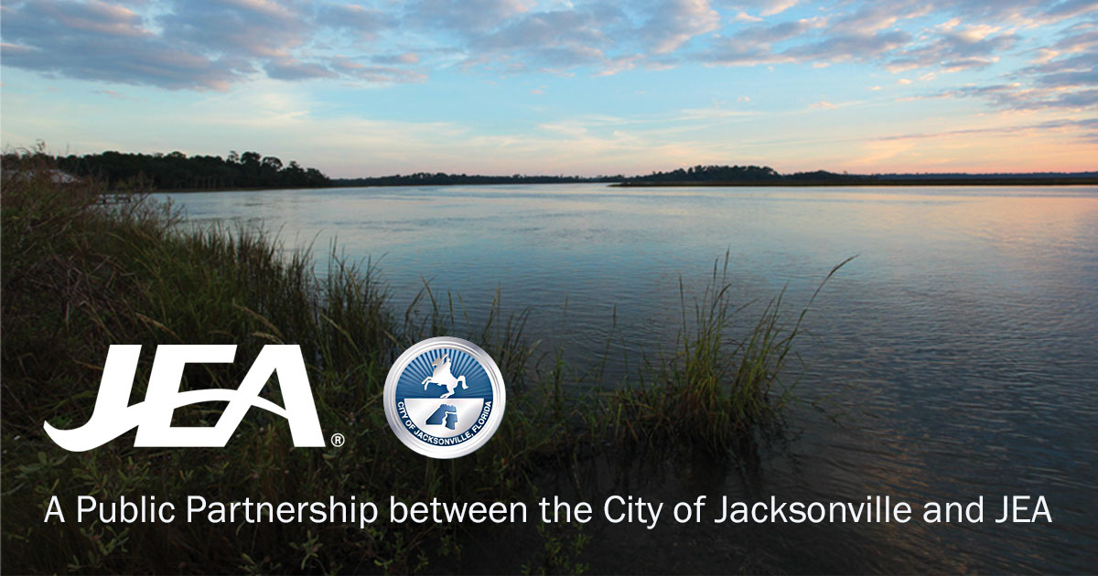
In 2019, JEA sought innovations in alternatives to septic systems
Septic Tanks
Select the best wastewater management strategy solution for each STPO priority area
Recognize technological advances
Evaluate possible program cost reductions
Notes:
JEA recently embarked on a program to replace aging septic systems within JEA’s service area, which will improve the environment and promote economic growth by making wastewater service available throughout the developed portions of Duval County. The ongoing Septic Tank Phase Out (STPO) program prioritized approximately 22,000 parcels with existing septic systems into 35 wastewater management areas (WMAs). The project will assess and recommend innovative technologies and approaches that can be applied to these prioritized areas. The approaches identified here can also be used in the future for the approximately 43,000 additional septic systems that remain in Duval County.
The main objectives of this project are:
Identify available innovative wastewater technologies and management strategies that can applied to STPO priority WMAs.
Evaluate identified technologies, wastewater management strategies and institutional frameworks for consideration by JEA.
Characterize the 35 priority WMAs and evaluate potential solutions.
Develop a Master Plan recommending a wastewater management solution for each of the WMAs.

Slide 11




The overarching goal of the Master Plan is to optimize the phaseout program – while recognizing realistic financial considerations
Phase 1
Technologies Literature and Industry Best Practices Review and Screening
Phase 2
Geographical Master Conceptual Plan
Phase 3
Phase 4
Potential Pilot Testing
Public Education
.
.
.
.
Notes:
The overall program includes four phases for development of a Master Plan:
Phase 1: Technologies Literature & Industry Best Practices Review and Screening
Phase 2: Geographic Conceptual Master Plan
Phase 3: Potential Pilot
Phase 4: Public Education Program

Slide 12






Institutional
Frameworks
Treatment
Technologies
Management
Strategies
Funding
Master Plan
Notes:
The following define the major components of the Phase 1 assessment:
Wastewater Management Strategies: strategies for managing WMA wastewater in lieu of septic systems (such as onsite, decentralized, centralized, integrated, source separation, etc.)
Technologies: equipment developed for wastewater collection, treatment, and/or effluent disposal (such as vacuum sewer system, biological treatment, engineered wetlands, etc.)
Institutional Frameworks: methods used to own, operate, finance, and implement wastewater management strategies (such as public, private, design/build/operate/finance, etc.).
The following approaches and criteria were used to assess the above:
Wastewater management strategies were assessed for proven/successful implementation, ease of implementation, secondary impacts, and providing an environmental benefit.
Wastewater collection technologies were grouped and evaluated based on technology maturity and experience, regulatory considerations, and ability to meet programmatic goals.
Onsite wastewater treatment technologies, (defined as single dwelling or building systems used to collect, treat and disperse or reclaim wastewater where it is generated) were grouped into process types and were evaluated based on technology maturity and experience, regulatory considerations and ability to meet programmatic goals (effluent water quality).
Decentralized wastewater treatment technologies, defined as treating average daily flows greater than 5,000 gallons per day (gpd), were grouped into process types and were evaluated based on technology maturity and experience, regulatory considerations and ability to meet programmatic goals (effluent water quality).

Slide 13

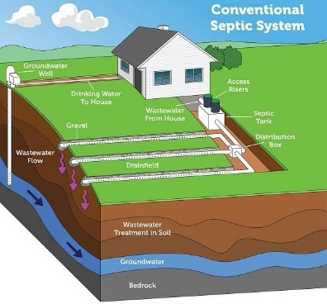

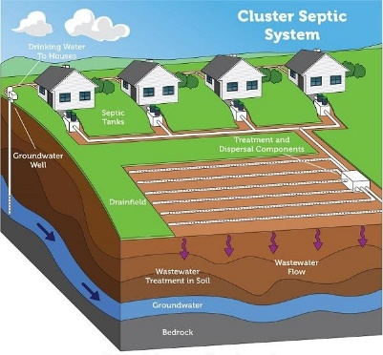

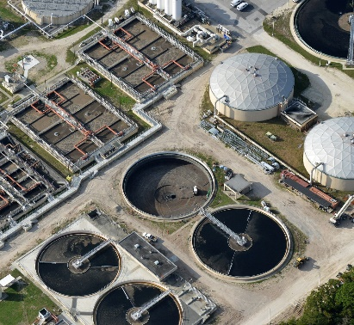
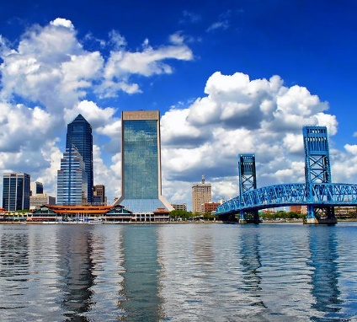

Master Plan work started with a literature and industry best practices review to identify possible solutions
  Single dwelling or building
  on-lot collection, treatment and disposal
Onsite
  Multi-source collection
  small-scale treatment facility
Decentralized
  Multi-source collection
  large (existing JEA) treatment facility
Centralized
  Hybrid
  combination of above
Integrated Management
Notes:
Goal is to document the findings of the literature and industry best practices review conducted of regional, national and international research regarding innovative technologies, strategies and frameworks for septic system conversion. This assessment identifies various manufacturers, viability, limitations, costs, challenges, lessons learned and other aspects of these technologies, strategies and frameworks through synthesis of literature, conference proceedings, case studies, reports and manufacturers technical materials both in the US and internationally.

Slide 14
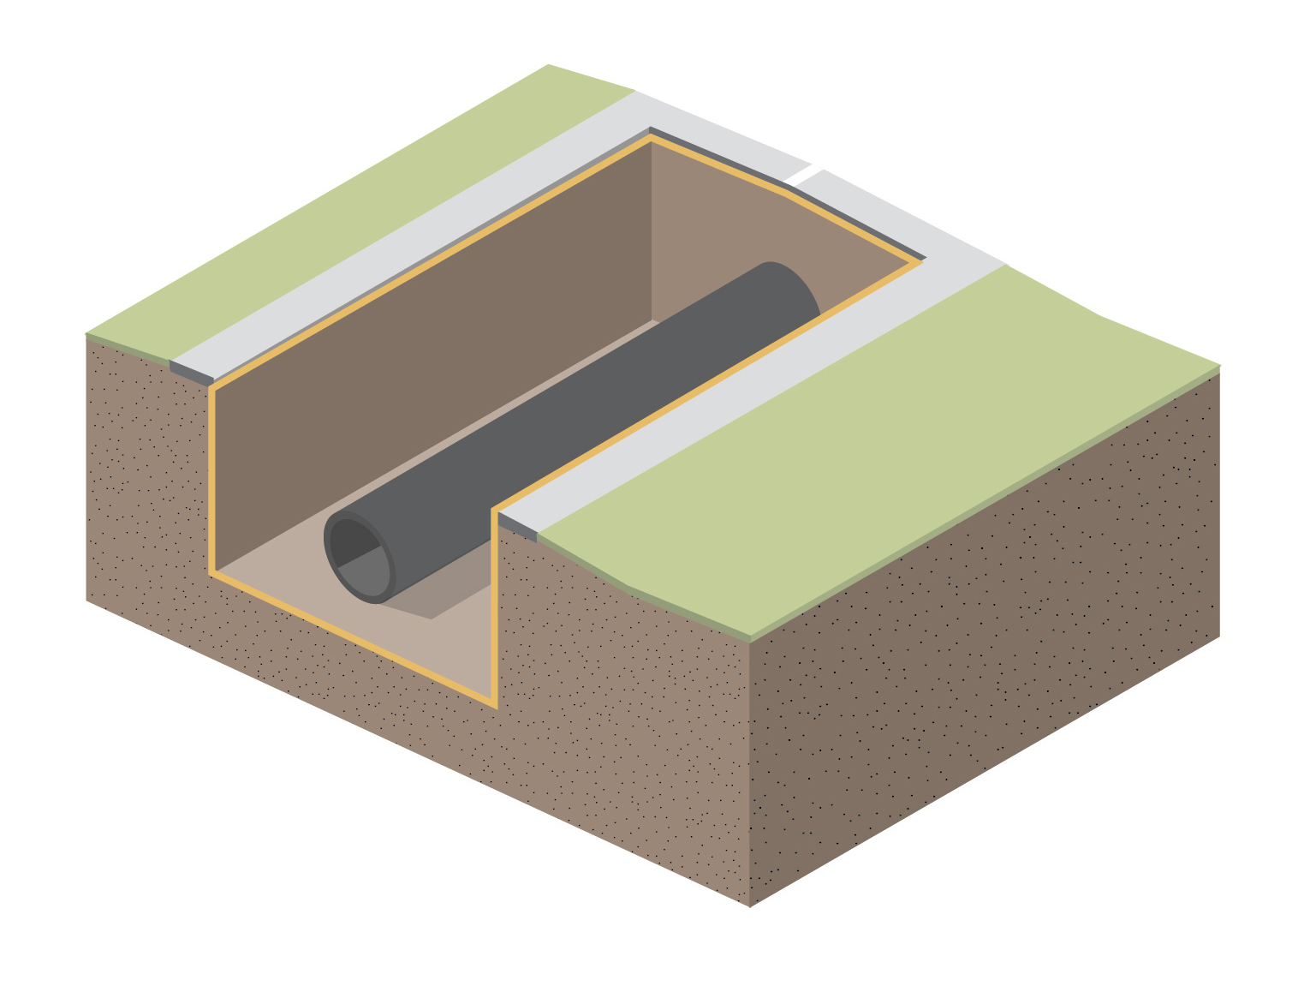
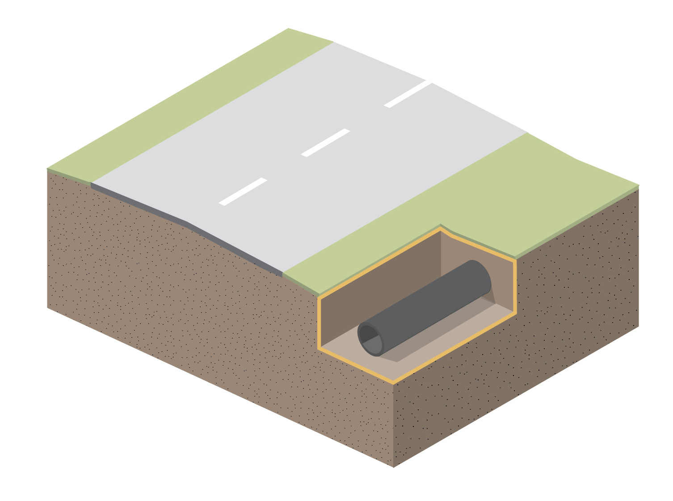
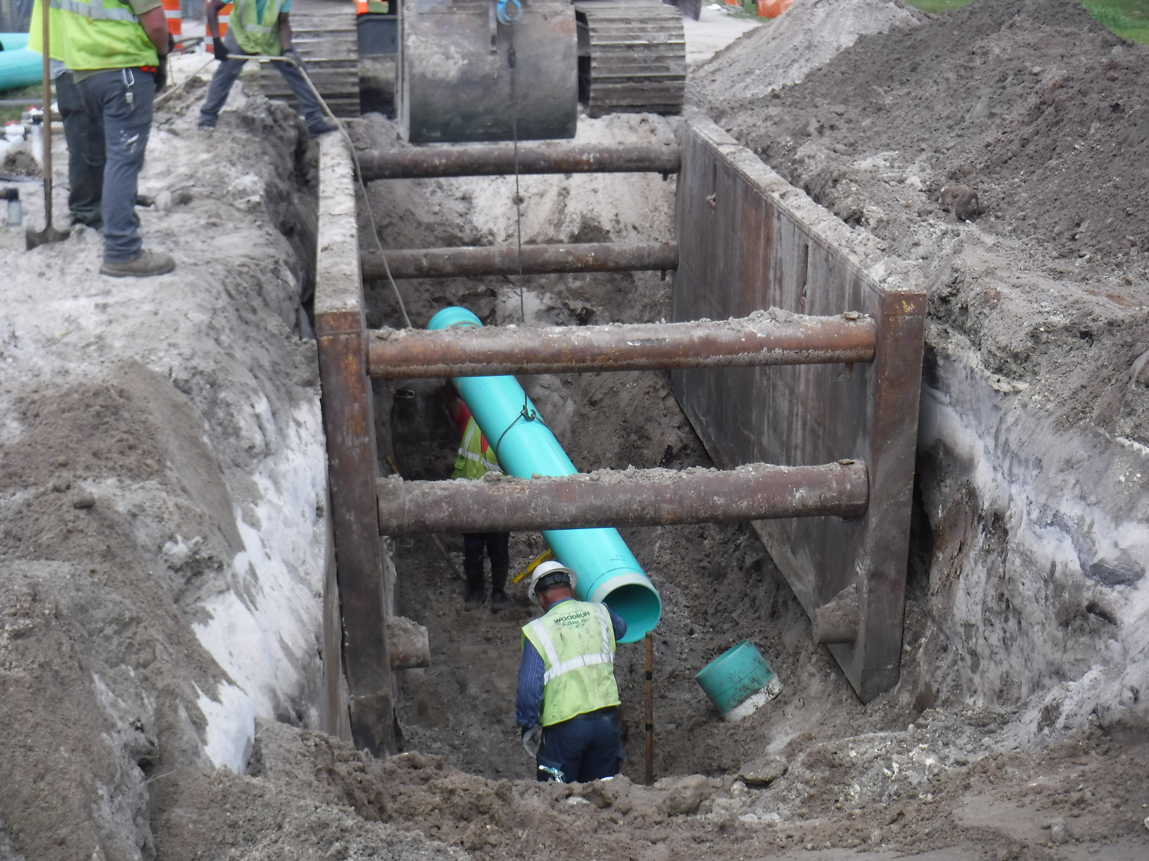
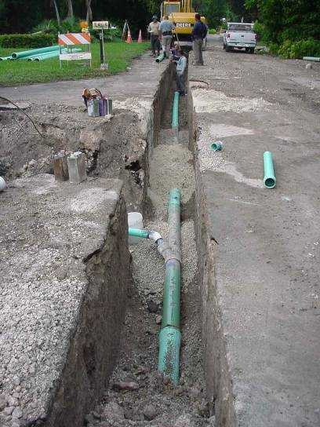
Possible solutions include alternative sewer collection and transmission systems
Conventional gravity sewers
Larger diameter
Deeper installation
Low pressure, vacuum sewers
Smaller diameter
Shallower installation

Slide 15
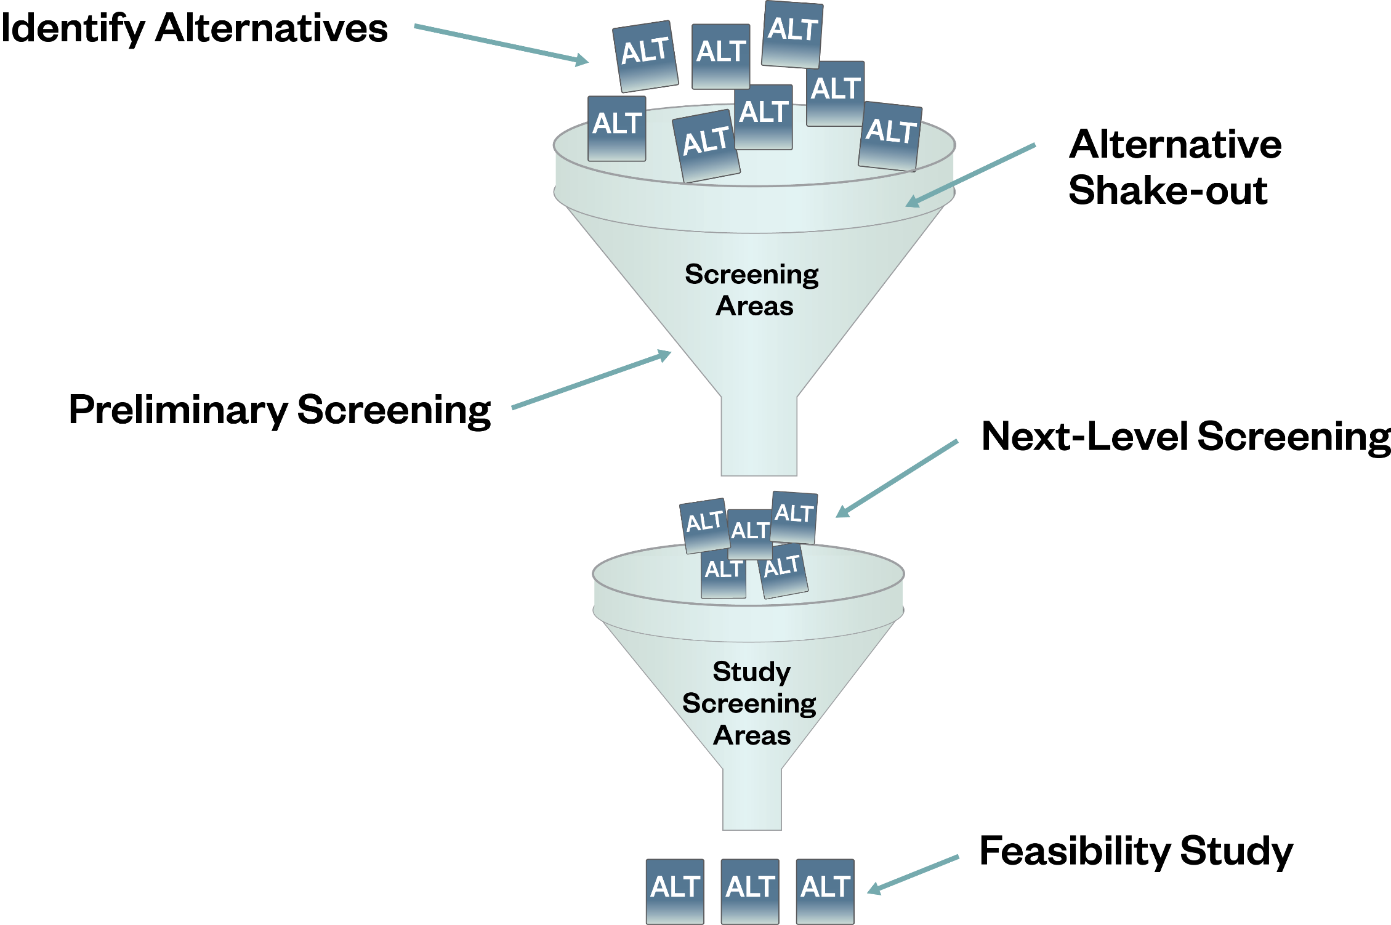
Possible solutions are being screened using decision making criteria
Project Area Characterization

Slide 16
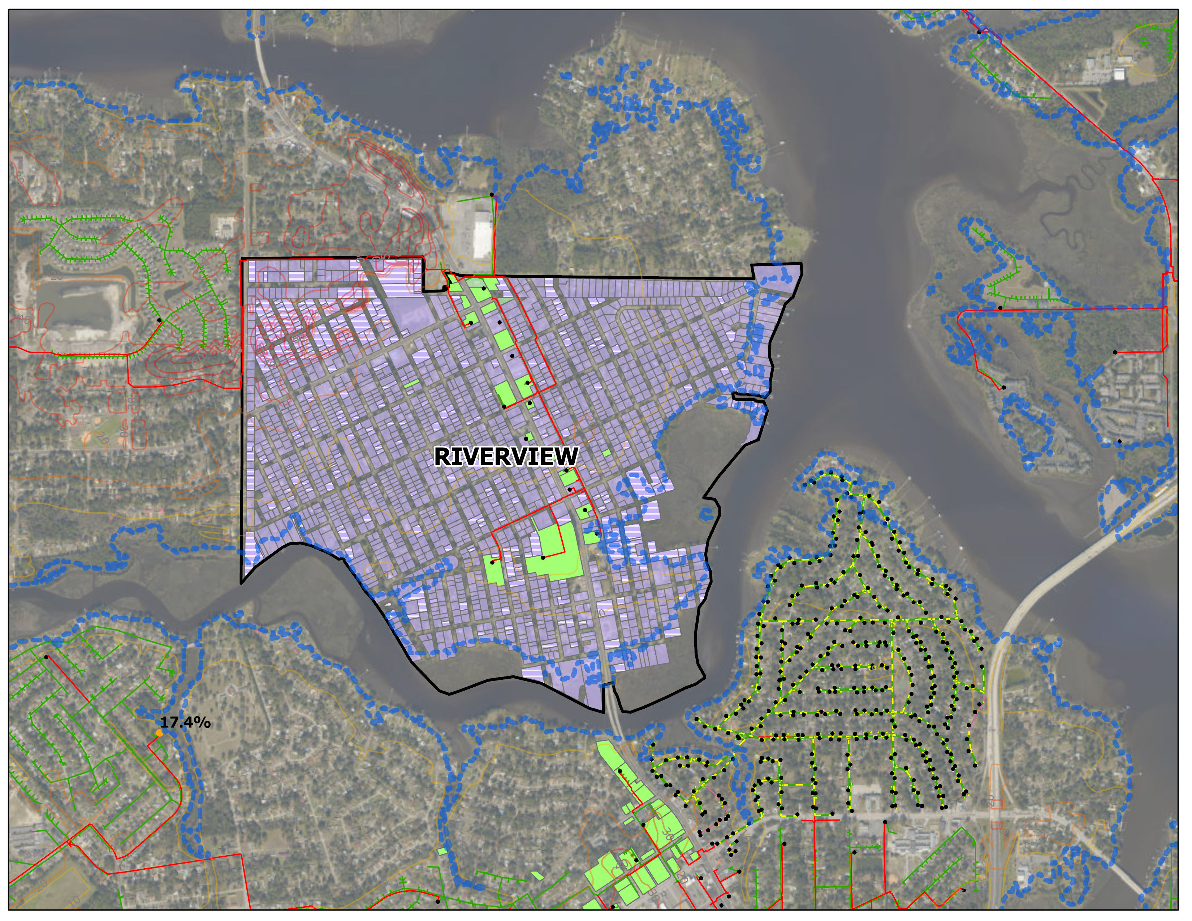
Characterization of the STPO project areas will be used in screening possible solutions
Rise in Sea Level YR2060
Ex. WW Network
Characterization:
Existing customers
Land Use
Existing Utilities
Topography
Environmental factors (including sea level rise)
Septic System
Ex. Customer
Notes:
Currently characterizing the prioritized parcels within the 35 WMAs in the STPO program for land use characteristics, system density, length of frontage roadway to parcels, topography, applicable TMDL limits, wastewater flow projections, etc. utilizing geographic information system (GIS) data. This data will be used to assess the WMAs for initial screening of recommended strategy onsite/decentralized vs centralized.

Slide 17
Criteria will be used to screen potential technical solution(s) within already prioritized STPO areas
Maximize Benefits of WW Management Alternatives
Implementability
Environmental Impacts
Nitrogen Reduction
Ability to Phase
Ease of Siting
Cost
General impact to rate payers
Ease of Management
Construction Impacts (Env.)
Secondary Impacts
Odor/
Aesthetic
Short Term Construction Impacts
Reliability
Climate Resiliency
Regulatory Acceptance
Potential for Reuse
Potential for Disruption from Construction Breakage
Public Perception

Slide 18
JEA’s
Innovative Wastewater Treatment Program
 | Completion Date
Phase 1 Reporting | 12/2020
Phase 2 Master Plan Report | 05/2021

Slide 19
Agenda
Impact of the county's 65,000 septic tanks on the environment/water quality and JEA's plan to eliminate or upgrade
Plans to upgrade treated water quality discharge into the St. Johns and alternatives to re use rather than discharge
Expansion of treated stormwater for irrigation plan
Diversification of energy sources for energy production and plan to reduce fossil fuels as a percent of the total to reduce greenhouse gas emissions

Slide 20
JEA TN Discharge to St. Johns River
TMDL Permit Limit
1536 Tons/Year
September 30, 2014
Permit Limit
720 Tons/Year
FY 2020
299

Slide 21

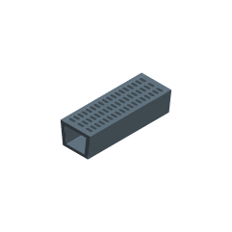



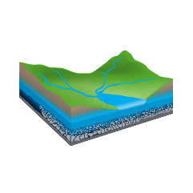
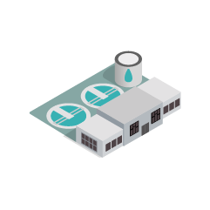
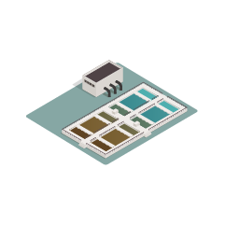
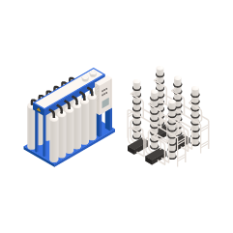
Integrated Water Resource Planning
Retention basins
STORMWATER CAPTURE
Augmentation of reclaimed system, and reduces runoff and pollution
Stormwater Drainage System
WATER CONSERVATION
Not Managed by JEA
Reduced water demand and water treatment
Water Supply
Drinking Water Treatment
Municipal Water Demand
Water Reclamation
Environment (Receiving Waters)
Indirect potable reuse
Direct potable reuse
Traditional reclaimed system
Surface Waters
Water Purification
Notes:
Went away from linear planning to an integrated approach, where water conservation, water reclamation and reuse, water purification, indirect and direct potable reuse, and storm water all are connected as part of the water cycle.
Took into consideration water supply certainty (ability tot meet seasonal demands of average and dry weather seasons), cost-effectiveness of solution (both near term change in customer rates and long term unit cost of water supply), environmental stewardship (reduced ww discharge and increased groundwater sustainability), community acceptability/implementation ease, operational flexibility.

Slide 22
Water Supply Options
Incremental Water Resource Cost
Water Supply Source |  |  | Levelized Cost ($/Kgal)
 |  | Traditional Floridan Aquifer | $0.62
x 3 |  | Water Conservation | $1.30 to $2.40
x 5 |  | Traditional Reclaimed | $3.00 to $5.3
x 5 |  | Potable Reuse | $2.90 to $6.10
x 5 |  | Brackish GW Desalination | $2.60 to $5.30
Levelized unit costs were developed assuming financing over 30 years at a discount rate of 2.5%.
Cost include Capital and O&M for Water Supply production only, does not include distribution and administrative cost
Stormwater and Surface water supply were evaluated and determined not feasible in the JEA service area

Slide 23
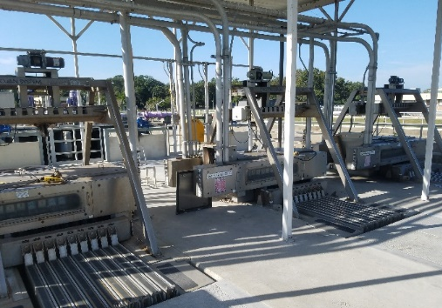
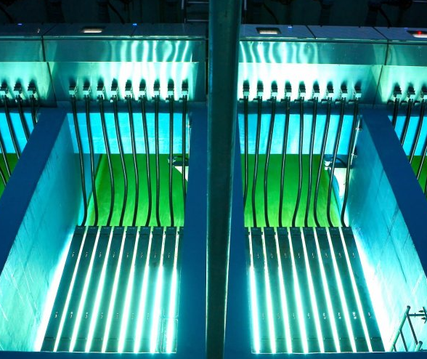
Water Supply – Near Term Solutions
IWRP Recommendations
Continue water transfer between grids when feasible (TWMP & SIPS program)
Continue expansion of JEA’s reclaimed water system
Implement Comprehensive Muti-Year Demand Side Management (DSM)/Conservation Program
Bring Alternative Water Supplies (AWS) online by 2027:
  Augment aquifer with indirect potable reuse
  Brackish groundwater desalination where effluent is not readily available
Notes:
DSM: high-efficiency toilets and appliances, smart irrigation, ice machine, cooling towers

Slide 24





Water Supply Solutions
Purified Water Program (Potable Reuse)
Phase I
Phase II
Phase III
Purification is one cost competitive option to meeting future demands
Protect water resources of the region
Directly decreases the effluent conveyed to the river
Public education is critical for successful implementation
R&D PILOTING
  Technology Evaluation
  Completed 2019
DEMONSTRATION
  Optimize treatment
  Public education & tours at demonstration facility
  Staff Training
IMPLEMENTATION
  Full Scale Implementation
  System expandable as demands increase
CONSERVATION
RECLAIMED
WATER
PURIFIED
WATER
BRACKISH
GROUNDWATER
SURFACE
WATER
INCREASING COST AND COMPLEXITY

Slide 25
Water Supply Solutions
Brackish Groundwater
SE Duval
County
East Duval
County
Brackish Groundwater utilizes a layer of the aquifer not currently being used.
This source could be implemented where a source for potable reuse is not readily available.
Salinity ranges from 1,000 to 6,000mg/L, (Ocean 35,000 mg/L) which will require reverse osmosis for treatment.
This option would not reduce discharge to the St. Johns River.
Land Surface
Upper Floridan
1
2
Typical JEA Drinking Water Well is 350 to 1,300 feet deep
Lower Floridan
3
(Top)
4
Lower Floridan
5
(Middle)
6
Lower Floridan
(Bottom)
7
Brackish Zone is 1,800 to 2,600 feet deep
Lawson
Limestone
25

Slide 26
Agenda
Impact of the county's 65,000 septic tanks on the environment/water quality and JEA's plan to eliminate or upgrade
Plans to upgrade treated water quality discharge into the St. Johns and alternatives to re use rather than discharge
Expansion of treated stormwater for irrigation plan
Diversification of energy sources for energy production and plan to reduce fossil fuels as a percent of the total to reduce greenhouse gas emissions

Slide 27
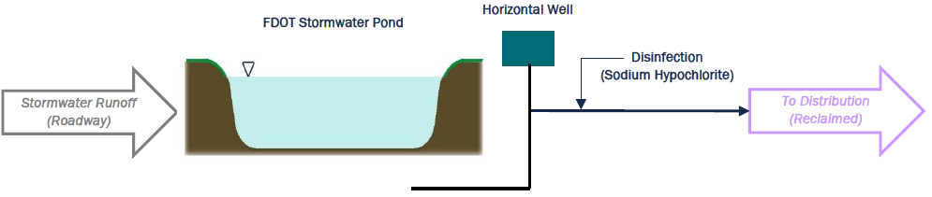
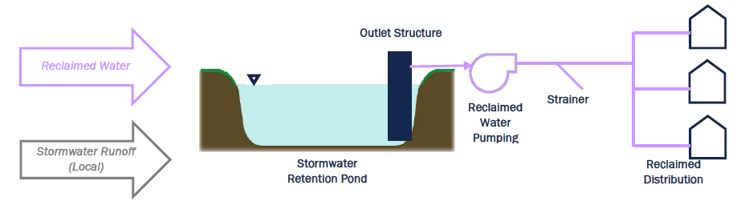
Stormwater Collection
Distributed Stormwater Collection from FDOT Facilities
Horizontal well fields adjacent to FDOT stormwater retention ponds
Disinfection systems
Transmission piping to nearby reclaimed water facilities
@yield of 5 MGD, annualized cost = $4.47/1000 gallons
Distributed Stormwater Collection and Dual Reclaimed Storage
Raised outlet structure, submersible pumps, strainers
Distribution network to supply reclaimed water to ponds and to extract water for irrigation
@ yield of 5 MGD, annualized cost = $2.67/1000 gallons

Slide 28
Stormwater Collection Issues
Logistics
  Location
  Storage capacity
Water supply
  Mass balance
Cost vs Benefits
  Under-utilization of assets
Water Quality
  Pollutants
Community Feedback
  Aesthetics
Notes:
The big difference between JEA using a pond and a private community (Nocatee) is the treatment required by FDEP. If JEA pulls water from a ponds and sends it to a second party it requires treatment. If you pull water out and use it on your property no additional treatment is required.
Talking Points for Storm water harvesting.
Logistics
The logistic of matching up a storm water pond near a treatment facility is difficult. Most of the ponds previously designed do not have adequate storage designed into the pond to serve as a water source. The optimum solution is to find a pond in the planning stage and design it accordingly, near a treatment facility.
Community feedback
JEA has approached private development owners and the Developers were not in favor of the idea. They use ponds for more aesthetic reasons and were worried that using the ponds for a water source would create a large level fluctuation which would make the ponds unsightly.
Water supply certainty & Cost Benefit
The water is usually needed when it hot and dry and there has been no rain. This typically matches up when the ponds are at the lowest point and there is no excess water. The mass balance typically doesn’t work.
JEA already has enough water during most of the year. Storm water pond augmentation would only be utilized 3 months at of the year at most. Building a storm water collection system and treatment for only 25% utilization driven the unit cost of the water up. This make this option not financially beneficial.
Water quality
Runoff from the roadways pick up pollutants that may harm lawns. Storm water is highly susceptible to a variety of contaminants. It becomes increasingly difficult to certify the quality of the water source.

Slide 29
Agenda
Impact of the county's 65,000 septic tanks on the environment/water quality and JEA's plan to eliminate or upgrade
Plans to upgrade treated water quality discharge into the St. Johns and alternatives to re use rather than discharge
Expansion of treated stormwater for irrigation plan
Diversification of energy sources for energy production and plan to reduce fossil fuels as a percent of the total to reduce greenhouse gas emissions

Slide 30
JEA’s Diversified Generation Fleet
Additions
2000
Kennedy CT 7
2001
Brandy Branch
CT 1-3
2003
Northside ST 1-2
2005
Brandy Branch
Combined Cycle
2007
Constellation
Winter PPA
2008
Trail Ridge
Landfill 1
2009
Kennedy CT 8
Boldface = Current
1980
Southern Company PPA
1987-1988
SJRPP 1-2
1989
Scherer 4
Future
2021-2022
MEAG Nuclear PPA
2021
FPL Combined Cycle PPA
2022
5 x 50 MW Solar Farms
1972-1973
Kennedy CT 3-5
Northside 2
1974-1975
Northside CT 1-4
1977
Northside ST 3
(100% Oil: NG conversion in 1986)
2010
Jax Solar
2011
Greenland
CT 1-2
2015
Trail Ridge
Landfill 2
2017-2019
27 MW Solar
Farms
2018
Wansley PPA
2019
Brandy Branch
CC Upgrade
1950-1964
Kennedy 8-10
Southside 1-5
1966
Northside 1
Pre-1970s
1970s
1980s
1990s
2000s
2010s
2020s
Retirements
1982-1983
Kennedy 8
Northside 2
Southside 1-3
2000-2001
Kennedy 10
Northside ST 1
Southside 4-5
2008-2009
Kennedy CT 3-5
2010
Southern PPA
Constellation PPA
2018
SJRPP 1-2
2019
Wansley PPA
2021
Scherer 4
2026
Trail Ridge
Landfill 1 & 2
1990
Kennedy 9
Resiliency and Sustainability supported with diversified generation units, fuel sources, and transmission
ST – Steam Turbine CT – Combustion Turbine CC – Combined Cycle PPA – Power Purchase Agreement

Slide 31
JEA Units CO₂ Emission Rate
Natural Gas Combined Cycle units releases 1/3 of CO₂ emission per megawatt-hour as compared to the Solid Fuel units.
300
300
525
575
850
Projected FY2022 Capacity Factors
200
250
200
MW
57%
54%
38%
93%
5%
95%
28%
70%
625
625
200
Coal-Fired Unit Retirements
SJRPP in 2018
Plant Scherer: Dec 31, 2021
Coal/Petcoke
Natural Gas
CT – Combustion Turbine CC – Combined Cycle PPA – Power Purchase Agreement
Power Purchase Agreements (PPA’s) CO2 emissions are attributed to the owner of the generating units.
Diesel CT at 4 Tons per MWh are only used for annual peak hour demand periods, producing less than 0.05 percent of annual generation.

Slide 32
JEA System CO₂ Emissions
SJRPP 1 and 2 Retirement in December 2017 resulted in an average reduction of 4,800 kTons of CO₂ emissions per year
Scherer 4
Retirement in December 2022 will result in an additional reduction of 1,300 kTons of CO₂ emissions per year - approximately 17% of total CO₂ emissions attributed to JEA⁴ as compared to the Base Case.
Net Energy
Historical
Projection
Zero CO₂ emissions for Vogtle 3 & 4, 5x50 Solar and FPL PPA⁽⁴⁾
Brandy Branch CC
Scherer 4
FPL PPA
Northside 3
SJRPP 2
5x50 Solar
Northside 2
SJRPP 1
Vogtle 3 & 4
Northside 1
All CTs
SoCo PPA⁽¹⁾
CO2 emissions from 200 MW Power Purchase Agreement (PPA) in 2005 - 2010 are not included as emissions are attributed to the owner of the power supply
SJRPP 1 and 2 CO2 emissions based on JEA’s 80% Ownership, where the joint ownership agreement shared the output MWh at a 50%/50% arrangement.
Scherer 4 CO2 emissions based on JEA’s 23.6% Ownership.
Approximately 600 kTon of CO2 emissions per year from 200 MW of PPA starting 2022 are attributed to the owner of the Power Supply entity of the PPA.

Slide 33
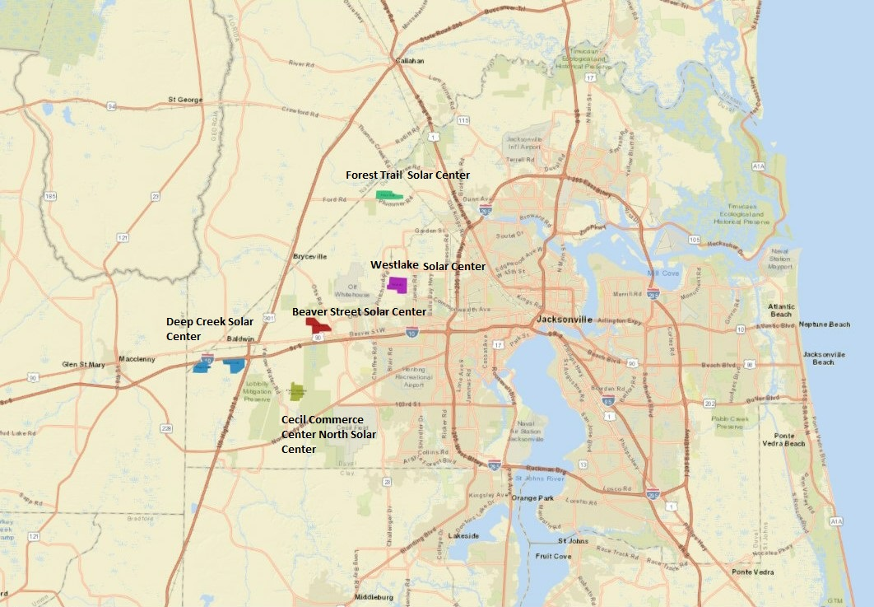
Five x 50 MW Solar Farms = 250 MW
Facility Name | Estimated Construction Start Date | Estimated COD
Cecil Commerce Solar Center | Jul 2021 | May 2022
Westlake Solar Center | Aug 2021 | Jul 2022
Deep Creek Solar Center | Sep 2021 | Aug 2022
Beaver Street Solar Center | Nov 2021 | Oct 2022
Forest Trail Solar Center | Jan 2022 | Dec 2022
JEA currently has a total of 58 MW of solar within JEA’s service territory, of which include 12 MW Jacksonville Solar facility, 7 MW Northwest Jacksonville Solar facility and approximately 19 MW of Net Metering, making Jacksonville one of the Top 20 U.S. Cities for Solar Energy.
These generate approximately 108,000 MWh of solar energy per year. The 250 MW of solar farms commencing in 2022, will provide JEA an additional of 600,000 MWh of solar energy per year.

Slide 34
Future Generation Considerations
[FY2026 – FY2028 Capital Expenditures]
NS3: 525MW Gas/Oil-Fired, 1977 Commercial Operation Date
  Section 316(b) of the Clean Water Act - Upgrades range from modification of water intake structure to constructing cooling tower, with a potential cost up to $150 Million
  Additional upgrades will be required to extend the life of the 43 year old generating unit
Future Generation Capacity Considerations for 500 MW
  Self-Operated Generation – New 500 MW Natural Gas Combined Cycle to replace NS3
  Jointly-Operated Generation – Natural Gas Combined Cycle with New Transmission or Existing Transmission upgrades
  Power Purchase Agreement – Natural Gas Combined Cycle with New Transmission or Existing Transmission upgrades
  Combined approach based on technical and economic feasibility
    Battery Storage on Existing Solar Farms
    New Solar Farms plus Battery Storage
    Demand Side Management / Energy Efficiency
    Power Purchase Agreements
Integrated Resource Plan (IRP) will be updated and completed in FY21/FY22 to provide viable options.
Approximately $5 million of study and permitting cost during FY21-FY25 prior to a final decision point ~FY2025

Slide 35
QUESTIONS?

